Slide 1
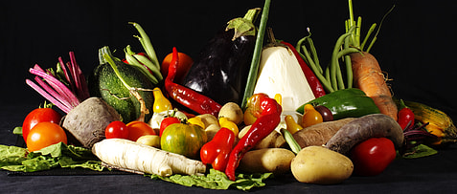

Burgers to Broccoli
In this challenge set by Hugo, we were tasked with finding out how technology can solve problems surrounding healthy eating.

Slide 2

Market Research
After chatting to the chatbot and conducting some online research, I discovered that in 2023, the House of Commons Library reported that 63.8% of people in the UK were either overweight or obese. While obesity has many causes, two of the main issues are the lack of knowledge around healthy food and the budget constraints that families face. According to the UK Parliament, over 20% of the population lacks access to healthy foods, with people opting instead for cheap, unhealthy foods. Additionally, busy families often feel they lack the time to prepare healthier meals, resorting to quick 'ready meals' high in salt and saturated fats, which can contribute to obesity when consumed regularly

Slide 3


Problem statement:
“Busy people struggle to find healthy, budget friendly meals for themselves (and their children) that match their time constraints and cooking ability.”
Solution:
- Develop an app prototype that provides users with a range healthy recipes tailored to their budget, time constraints, and dietary requirements. Put simply, the user inputs their needs, and the app outputs a list of corresponding recipes for them to try.

Slide 4

Interviews
My first step was to conduct some person to person interviews to get to know more about the issues from a personal level and how I should tailor my app:
I asked them 6 questions:
1) How often do you cook?
2) How do you decide what to cook?
3) Can you tell me about the last time you searched for a recipe?
4) What tools do you use for meal planning, if any?
5) Can you describe your process of finding healthy meals that fit your budget?
6) If you could design the perfect recipe finding tool, what features would it have?
I interviewed 10 people and reviewed the results.

Slide 5
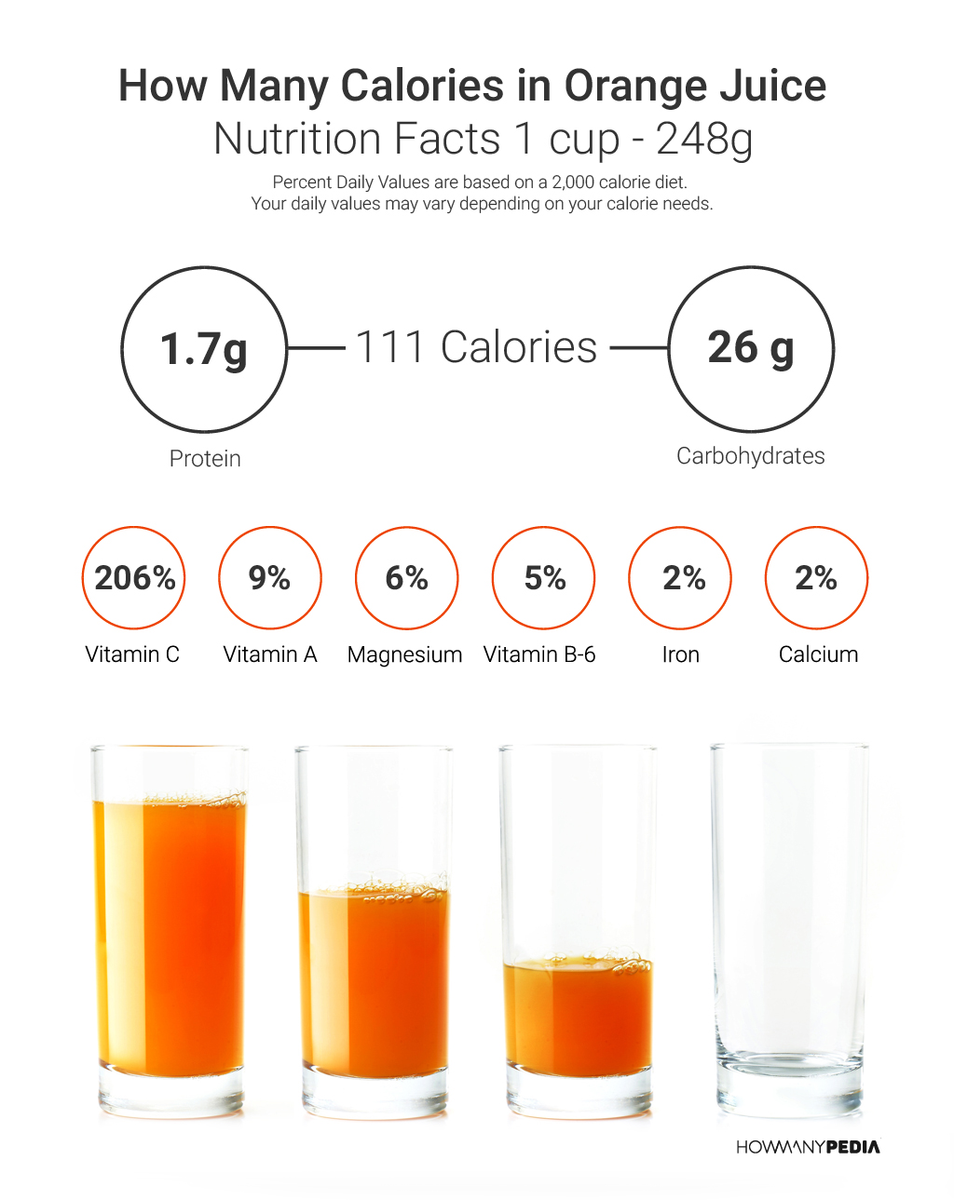



Conclusions
The interviews revealed two primary challenges in eating healthy: finding time to cook on a budget and understanding which foods are healthy and how to prepare them. Participants also expressed a desire for four key features within the app: being able to filter recipes by budget, time, calorie intake, and dietary requirements.

Slide 6

BudgetBites:
From all of this, I had enough to make a prototype for my app.
I used a combination of AI and my coding skills to create a programme that asks the user to input their budget, preferred calorie intake, time constraints and dietary requirements that takes these and finds suitable recipes from a database, which it then outputs to the user.

Slide 7
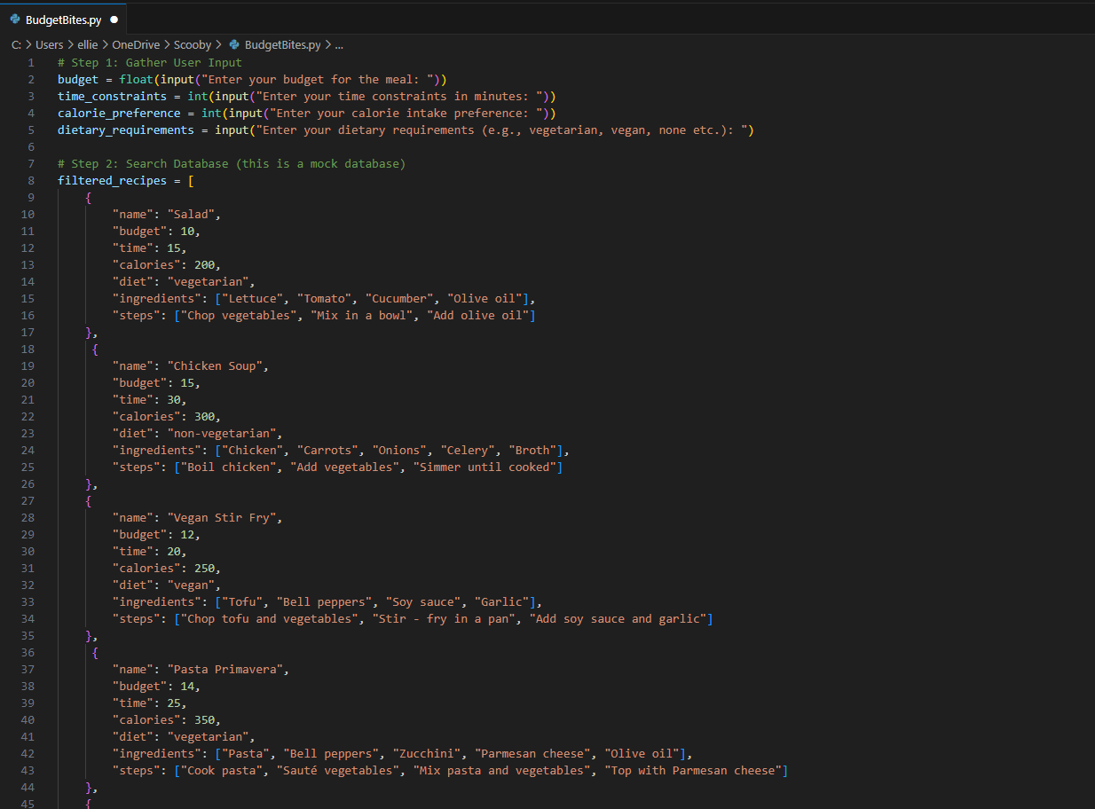
Notes:
The first step was to ask the user their needs, so the programme could narrow down suitable recipes. In step 2, I used AI to help build a mock database of recipes that could be used in part of the app.

Slide 8
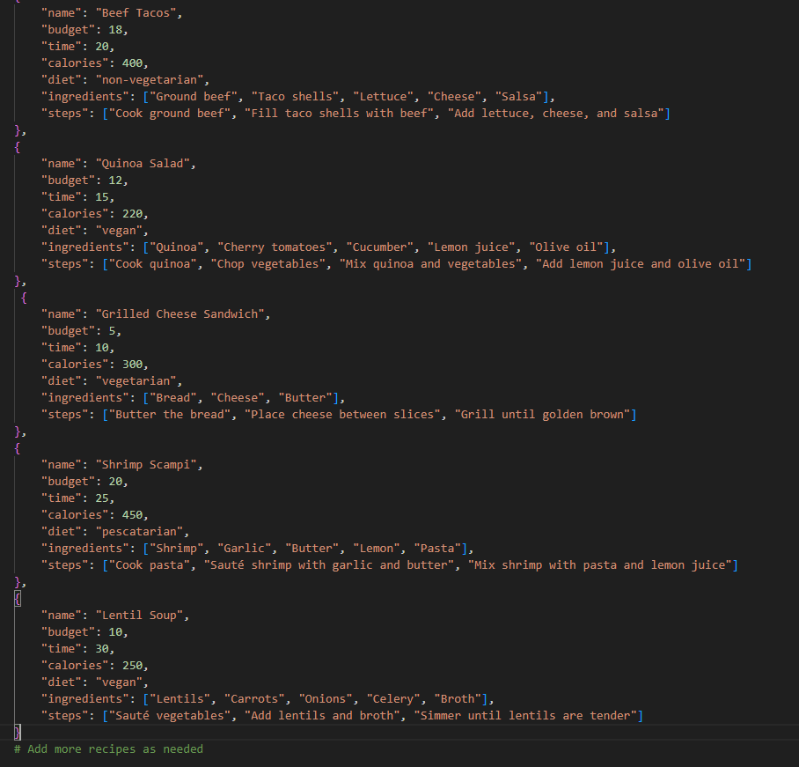
Notes:
The mock database displayed the name of the recipe, along with the budget, time taken to make, calories, dietary requirements and the steps to cook the food.

Slide 9

Notes:
Step 3 was to programme some code that would actually filter the recipes from the mock database using the information provided from the user. I then used AI to help me output the filtered results to the user.

Slide 10


Input
Output
Notes:
Here is an example of an input by a vegan user asking for a recipe which is quick (equal too or less than 30 mins) and with a budget of £10.

Slide 11
Advances and Limitations:
To use this on a large scale, I would need to integrate my program with multiple recipe websites to provide users with a wide variety of options to suit them specifically. Additionally, I would need to develop a feature to estimate what the total meal costs and, if not specified, calculate the calorie content.
This is a very simple prototype to a very complex problem, and while my coding skills are very basic, this app has the potential to include many additional features. For instance, it could ask users what type of meal they prefer, such as pasta dishes or salads, or, by linking to supermarket databases, the app could show where the ingredients for the meal are available for purchase and where is cheapest to buy them. Users themselves could also be able to add appropriate recipes to widen the choice of meals.

